Slide 1

Team Report – Prem CC
Sports vision and Cognitive evaluation of players
- SportOptima

Slide 2
EyeRIS Cricket

Slide 3

OVERVIEW
17 players from the squad were measured on various physiological aspects, including:
Vision
Visual acuity
Stereopsis
Physical
Grip strength
Cognitive
Visual memory
81% of the squad tested don’t wear corrective glasses.
For reference: NBA and NFL teams have a published value of ~87%
powered by SportOptima

Slide 4
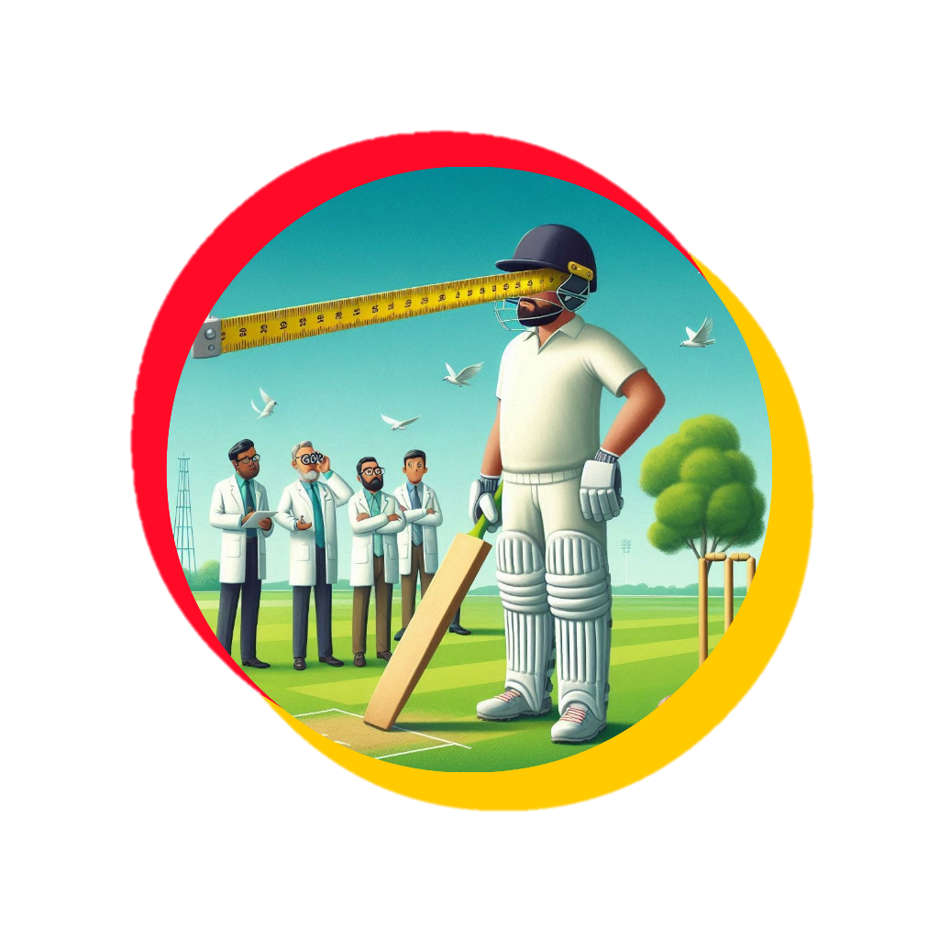
VISUAL ACUITY
Visual Acuity
Team Average: 6/5.1
Players using visual aid: 3
Quick Read:
Visual acuity is how far with clarity one can see
For an athlete, it's crucial because it determines how well you can see details, like the seams on the ball.
Good visual acuity helps you react faster and perform better in your sport.
Relevance on the field: Good high ball catchers
powered by SportOptima

Slide 5

DEPTH DISCRIMINATION
Team Average: 86.58 arc secs
Excellent stereopsis is below 40 arc secs
Quick Read:
Depth discrimination is your ability to judge how far away objects are from you and from each other.
It helps to accurately gauge distances—like knowing how far away an opponent or the ball is, judging the depth of a field, or timing movements to catch or hit a ball.
Good depth discrimination - improves spatial awareness and enhances performance in sports
Relevance on the field: Strategic ground fielding positions
powered by SportOptima

Slide 6

GRIP STRENGTH
Team Average: 40.31 kgs
Quick Read:
Grip strength is the power of your hands to hold, squeeze, and control objects.
It affects how well you can handle equipment, like a bat, racket, or ball, and perform tasks that require strong, steady hands, such as catching, throwing, and maintaining control during physical activity.
Strong grip strength helps improve overall performance and endurance in sport.
Relevance on the field: Accurate throwers of the ball
powered by SportOptima

Slide 7

REACTION TIME -Hand
Team Average: 696 ms
Quick Read:
Reaction time is how quickly you can respond to a stimulus.
It's the split-second it takes for you to see something—like a ball being thrown or a starting gun firing—and then move.
Fast reaction time helps to make quick decisions, dodge opponents, and execute plays faster than your competition, giving you an edge in your sport.
Relevance on the field: Quick reflex positions
powered by SportOptima

Slide 8

REACTION TIME-Leg
Team Average: 666 ms
Quick Read:
Reaction time is how quickly you can respond to a stimulus.
It's the split-second it takes for you to see something—like a ball being thrown or a starting gun firing—and then move.
Fast reaction time helps to make quick decisions, dodge opponents, and execute plays faster than your competition, giving you an edge in your sport.
Relevance on the field: Strategic single cutting positions
powered by SportOptima

Slide 9
Thank you
powered by SportOptima

